Slide 1
Subspace-Constrained Federated Learning with Low-Rank Adaptation
Neranjan Senarath
Rohit Muralitharan
Sadia Asif
Department of ECSE
Department of Computer Science
Department of Computer Science
CSCI 6962 Group G1
Rensselaer Polytechnic Institute
1
Notes:
[Sources] - Uploaded file CSCI_6960__Project_Proposal_G1 (2).pdf, page 1 (title, abstract, authors, and overall project framing).

Slide 2
Talk roadmap
1
Problem setting
2
Method
3
Theory
4
Experiments
5
Results + caveats
Why LoRA-based federated learning can suffer under non-IID client data.
Subspace-regularized objective, shared reference basis, and training loop.
How the paper frames silent cancellation and the role of the alignment parameter μ.
Dataset, model choices, baselines, hyperparameters, and evaluation diagnostics.
Complete 3-seed results on both models, the model-dependence finding, and the consistent basis overlap result.
2
Notes:
[Sources] - Slide content synthesized from the full paper structure in CSCI_6960__Project_Proposal_G1 (2).pdf, pages 1-10.

Slide 3
Motivation: why LoRA-based FL can break under heterogeneity
Why this matters
Federated learning enables privacy-preserving training without sharing raw client data.
LoRA makes large-model fine-tuning practical by constraining updates to a low-rank form ΔW = BA.
But under non-IID client data, different clients may span different low-rank subspaces.
Naively averaging these updates can reduce global progress even when each client improves locally.
3
Notes:
[Sources] - CSCI_6960__Project_Proposal_G1 (2).pdf, pages 1-2: introduction and motivation for heterogeneity, low-rank updates, and “silent cancellation”.

Slide 4
Where this project sits in prior work
FedAvg
FedProx
Periodic averaging of local model updates. Simple and communication-efficient, but unstable under heterogeneous local objectives.
Adds a proximal term to control client drift. The proposed paper borrows this idea, but applies it to low-rank geometry.
LoRA in FL
FedSVD
Represent update as ΔW = BA so only low-rank factors are trained and communicated.
Existing federated LoRA baselines emphasize aggregation and orthogonalization, but not explicit subspace regularization.
Gap identified by the paper: methods address magnitude drift or redistribution, but do not directly encourage client LoRA updates to stay in a compatible shared subspace.
4
Notes:
[Sources] - CSCI_6960__Project_Proposal_G1 (2).pdf, pages 1-2: related work on FedAvg, FedProx, LoRA, FlexLoRA, and FedSVD.

Slide 5
Method: subspace-regularized LoRA objective
Client objective
Why each term matters
1
Global reference
Server computes a shared low-rank basis via SVD and broadcasts it each round.
2
Regularized local adaptation
Task loss
Alignment penalty μ
Factor regularization λ
Each client can still personalize to its own data, but stays near the shared subspace.
Preserves each client’s local fine-tuning objective.
Pulls the update toward the current global reference subspace.
Keeps low-rank factors bounded and well-behaved.
3
Constructive aggregation
Combined update should preserve more signal because clients move in more compatible directions.
4
Key tradeoff
If μ is too small, misalignment persists; if μ is too large, local flexibility may be overly restricted.
Interpretation: FedProx-style regularization, but applied to the geometry of the low-rank subspace - not just update magnitude.
5
Notes:
[Sources] - CSCI_6960__Project_Proposal_G1 (2).pdf, pages 2-3: proposed objective and algorithm.

Slide 6




Theoretical analysis plan
Main analytical questions
Assumptions used in the convergence discussion
How can misaligned low-rank client updates reduce the norm of the aggregated update?
1
Smoothness
Each local loss is L-smooth.
2
Bounded heterogeneity
Can subspace alignment improve convergence under standard FL assumptions such as smoothness and bounded heterogeneity?
Client gradients differ from the global gradient by at most σ² in expectation.
3
Bounded variance
Stochastic gradients have variance bounded by ξ².
What role does μ play in controlling directional drift in the low-rank manifold?
4
Bounded low-rank factors
The Frobenius norms of A_k and B_k remain bounded.
7
Notes:
[Sources] - CSCI_6960__Project_Proposal_G1 (2).pdf, pages 3-5: theoretical analysis plan and Assumptions 1-4.

Slide 7
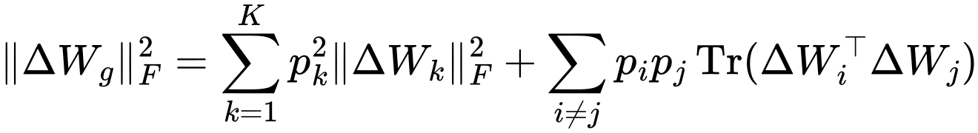
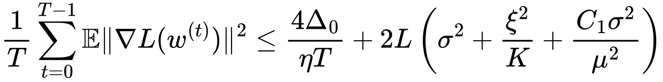
Main Theoretical results
Theorem 1: geometric cancellation bound
Theorem 2/3: convergence effect of alignment
The cross terms encode how aligned or misaligned client updates are.
The familiar FL error terms remain: heterogeneity σ² and stochastic variance ξ²/K.
Negative cross terms imply cancellation: aggregated progress is smaller than the sum of local progress.
Misalignment appears as an extra penalty proportional to 1/μ².
This formalizes the intuition behind “silent cancellation” under heterogeneity.
Increasing μ reduces this penalty, but too much regularization may restrict local adaptation.
Key message : the issue is not exploding gradients - it is losing effective update magnitude because directions do not match.
Compared to standard LoRA-FedAvg, we argue that a fixed cancellation term is replaced by a tunable one.
8
Notes:
[Sources] - CSCI_6960__Project_Proposal_G1 (2).pdf, pages 4-5: Theorems 1-3 and the interpretation of the μ-dependent misalignment penalty.

Slide 8
Training loop: how one federated round works
ALGORITHM
Round t workflow
Local optimization target
1
Sample clients
Server selects K participating clients for the round.
The extra α-term directly regularizes the basis matrix B_k toward the server basis B_g.
2
Build reference subspace
Aggregate previous low-rank updates and compute the SVD reference basis.
What is new relative to standard LoRA-FedAvg?
3
Explicit reference subspace from server-side SVD.
Regularized client updates
Penalty on update mismatch plus optional basis penalty.
Each client optimizes B_k and A_k while staying near the broadcast reference.
Goal is directional compatibility, not just smaller drift.
4
Aggregate global update
Server averages ΔW_k and updates the global model.
Key novelty: regularization acts on the direction of the low-rank update, not just its magnitude — extending FedProx to the geometry of the low-rank manifold.
6
Notes:
[Sources] - CSCI_6960__Project_Proposal_G1 (2).pdf, page 3: proposed algorithm and local objective.

Slide 9
Experimental design and reported hyperparameters
EVALUATION
Study design
Hyperparameters used in the completed run
Model
RoBERTa-large (completed) and SmolLM-360M (completed)
Hyperparameter
Value
Hyperparameter
Value
LoRA rank r
8
Basis reg. α
0.01
Dataset
HellaSwag commonsense reasoning benchmark
Local epochs E
3
Clients / round K
10
Local LR η_l
2e-4
Rounds
20
Federation
10 clients; non-IID partitioning
Global LR η
1.0
Dirichlet β
0.5
Baselines
FedAvg, SVD redistribution, FedSVD, proposed Subspace-Reg LoRA
Alignment μ
0.1
Why these diagnostics?
Reported completed setting
Diagnostics
Accuracy, loss, cancellation ratio, client-global cosine, pairwise cosine, basis overlap
The hypothesis is geometric, so accuracy alone is not enough. The paper also measures how compatible client subspaces are during aggregation.
Both models fully completed: 3 seeds × 4 methods × 2 models = 24 total runs on HellaSwag.
All 24 runs completed. Results on RoBERTa-large are consistent across 3 seeds; SmolLM-360M reveals model-dependent accuracy gains.
9
Notes:
[Sources] - CSCI_6960__Project_Proposal_G1 (2).pdf, pages 5-6: experimental plan, hyperparameters, and alignment diagnostics.

Slide 10
Metrics used to test the hypothesis
EVALUATION
Primary performance metrics
Alignment diagnostics
Best validation accuracy
Cancellation ratio
Peak performance reached during the run.
How much of the summed local update norm survives aggregation. Near 1 implies constructive aggregation.
Mean last-5 accuracy
Client-global cosine
Stability near the end of training.
Average cosine similarity between each client update and the aggregated global update.
Final validation accuracy
Pairwise client cosine
Where the model ends after 20 rounds.
Average mutual agreement among client updates themselves.
Final validation loss
Basis overlap
Whether the stronger accuracy also corresponds to better objective value.
How closely each client basis B_k aligns with the global reference basis B_g.
Key finding: Subspace-Reg achieves near-perfect basis overlap (~0.9999) on both models while SVD leads cosine metrics — showing basis overlap is the operative alignment mechanism.
10
Notes:
[Sources] - CSCI_6960__Project_Proposal_G1 (2).pdf, page 6 and page 8: definitions of evaluation metrics and interpretation.

Slide 11
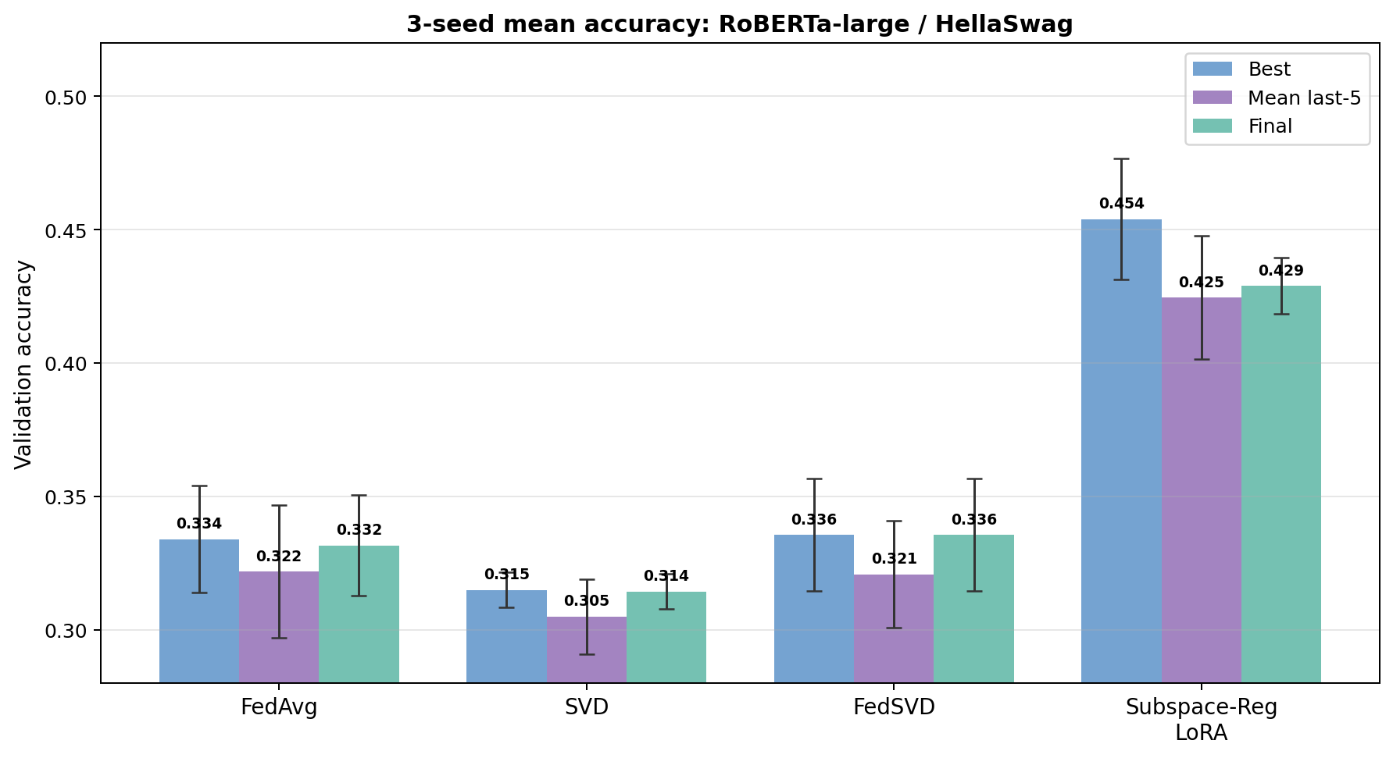
RoBERTa-large results: 3-seed mean accuracy
RESULTS
3-seed mean accuracy: RoBERTa-large / HellaSwag
Full 3-seed comparison (RoBERTa-large)
Best acc (Subspace-Reg vs best baseline)
0.454
vs
0.336
Mean last-5 (Subspace-Reg vs best baseline)
0.425 vs 0.321
Final acc (Subspace-Reg vs best baseline)
0.429
vs
0.336
11
Notes:
[Sources] - CSCI_6960__Project_Proposal_G1 (2).pdf, pages 6-7: Table 2 and Figure 1 for seed-42 accuracy metrics.

Slide 12
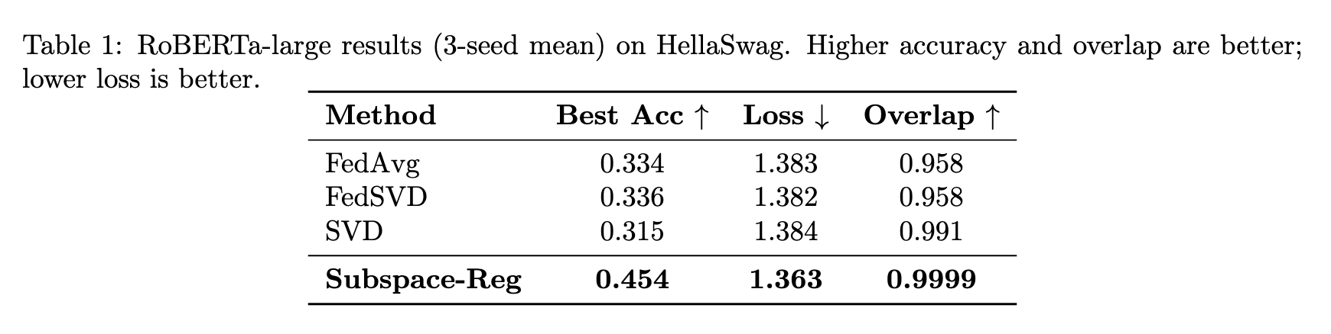
RoBERTa-large results: 3-seed mean accuracy
RESULTS
Full3-seed comparison (RBERTa-large)
Interpretation
Takeaway:
Subspace-Reg leads on every metric.
11
Notes:
[Sources] - CSCI_6960__Project_Proposal_G1 (2).pdf, pages 6-7: Table 2 and Figure 1 for seed-42 accuracy metrics.

Slide 13
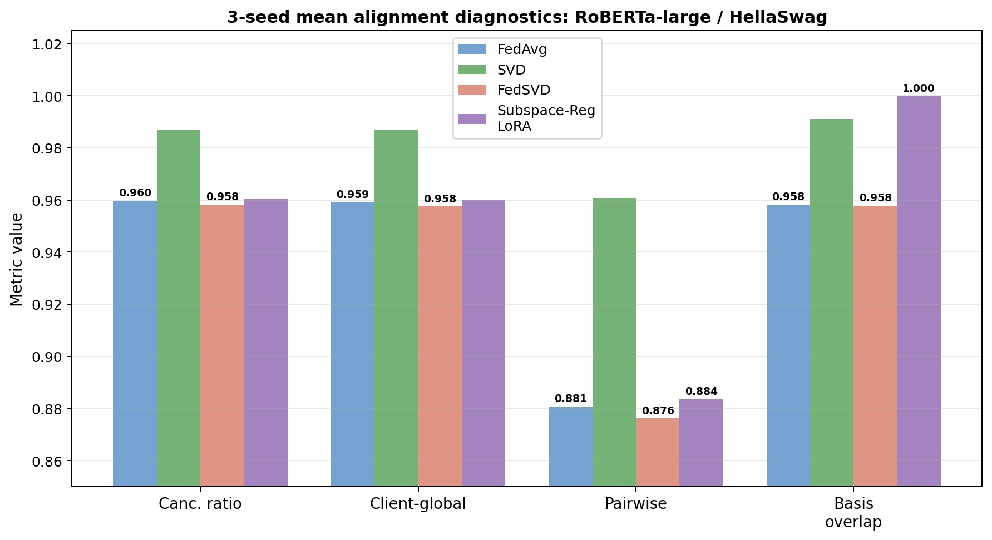
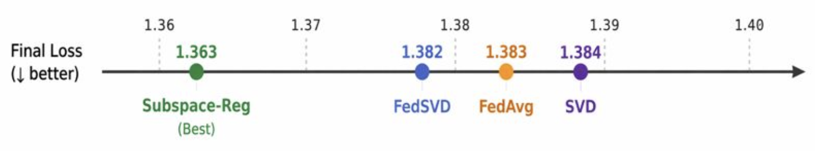
Alignment diagnostics explain what changed
RESULTS
3-seed mean alignment diagnostics: RoBERTa-large
Key insight
SVD wins cosine-based metrics, but Subspace-Reg dominates basis overlap across all 3 seeds on both models the diagnostic most directly tied to the alignment hypothesis.
Final loss supports the same story
Takeaway
Basis overlap is consistently ~0.9999 for Subspace-Reg on both RoBERTa-large and SmolLM-360M, versus ~0.958–0.991 for all baselines. This geometric result holds even when accuracy gains are smaller.
12
Notes:
[Sources] - CSCI_6960__Project_Proposal_G1 (2).pdf, pages 8-9: Figure 2, Table 3, and Figure 3 for alignment metrics and final loss.

Slide 14
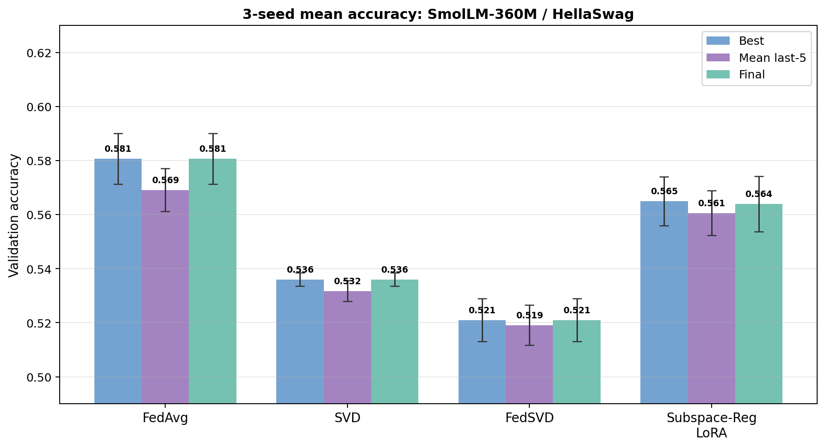
SmolLM-360M results: mixed accuracy, consistent alignment
STATUS
3-seed mean accuracy: SmolLM-360M / HellaSwag
3-seed mean results (SmolLM-360M)
Algorithm
Best
Mean last-5
Final
Basis Overlap
FedAvg
0.581
0.569
0.581
0.978
SVD
0.536
0.532
0.536
0.991
FedSVD
0.521
0.519
0.521
0.968
Subspace-Reg
0.565
0.561
0.564
0.9999
Key observations and discussion
On RoBERTa-large, Subspace-Reg leads all methods on accuracy AND loss (1.363 vs ~1.382–1.384). On SmolLM-360M, FedAvg leads on accuracy (0.581) and loss (1.108) gains are model-dependent.
Basis overlap (~0.9999) is consistently near-perfect for Subspace-Reg on both models, versus ~0.958–0.991 for baselines — the geometric effect is robust.
Future work: ablations on alignment strength μ, additional seeds, and larger models to test whether accuracy gains scale with model capacity.
FedAvg leads on accuracy (0.581), while Subspace-Reg retains near-perfect basis overlap (0.9999). Gains from regularization are model-dependent.
Tighter theoretical analysis should connect the measured basis overlap improvement to the convergence bound’s 1/μ² penalty term more directly.
13
Notes:
[Sources] - CSCI_6960__Project_Proposal_G1 (2).pdf, pages 9-10: Table 4, Figure 4, current status, next steps, and preliminary nature of the results.

Slide 15
Summary and conclusions
SUMMARY
1
Problem
2
Solution
3
Evidence
4
Caveat
Heterogeneous clients can learn different low-rank update subspaces, so naive averaging may silently cancel progress.
The method adds proximal alignment toward a shared global reference subspace, plus basis regularization.
Across 3 seeds on RoBERTa-large, Subspace-Reg leads all baselines on every accuracy metric. On SmolLM-360M, FedAvg leads on accuracy but Subspace-Reg retains ~0.9999 basis overlap on both models.
Accuracy gains are model-dependent: strong on RoBERTa-large, smaller on SmolLM-360M. Basis overlap consistency across both models is the most robust empirical result.
Bottom line: multi-seed evidence supports the subspace-alignment hypothesis on large encoders; model-dependence of accuracy gains warrants further investigation.
14
Notes:
[Sources] - Summary synthesized from CSCI_6960__Project_Proposal_G1 (2).pdf, pages 1-10, especially the conclusion and current-status sections.

Slide 16


